Slide 1
Assessment- ShopBridge Web App
Author- Dhirendra Singh
Date- 24 October 2021

Slide 2
Project Setup-
Execute database scripts in following sequence for table structure.
CreateShopBridgeDb.sql
Category.sql
Individual.sql
Product.sql
Role.sql
Permisssion.sql
User.sql
RolePermission.sql
CategoryProduct.sql
Audit.sql
Populate Initial Data with following script.
InsertPopulateInitial.sql

Slide 3
Modify ConnectionString In Web.config of WebPortalShopBridge project.
If we have different server other than local, then we have to specify in data source in place of dot(.) ,If we are using SQL Server authentication( Not windows authentication) use ‘integrated sercurity=False’ also provide username and password.
<connectionStrings>
<add name="ShopBridgeDbEntities" connectionString="metadata=res://*/ShopBridgeDbEntities.csdl|res://*/ShopBridgeDbEntities.ssdl|res://*/ShopBridgeDbEntities.msl;provider=System.Data.SqlClient;provider connection string=&quot;
data source=<!--server-name-->;initial catalog=ShopBridgeDb;integrated security=True;multipleactiveresultsets=True;application name=EntityFramework&quot;"
providerName="System.Data.EntityClient" />
</connectionStrings>
If we are using Microsoft Sql server on local machine and server is also hosted on same machine and using Windows authentication, then we are not require any change

Slide 4
Scope
Refer Readme.txt
Authenticate the user and based on his authorization give access to modules.
Currently we have by default Product Admin User with Role Admin.
Here are credentials- UserName-sysadmin@thinkbridge.in
Password-Sys123!
After Authentication user navigate to Shopping Page where list of existing product has been displayed.
Admin User can perform CRUD operation on Product.
Below find screen shots of application.

Slide 5
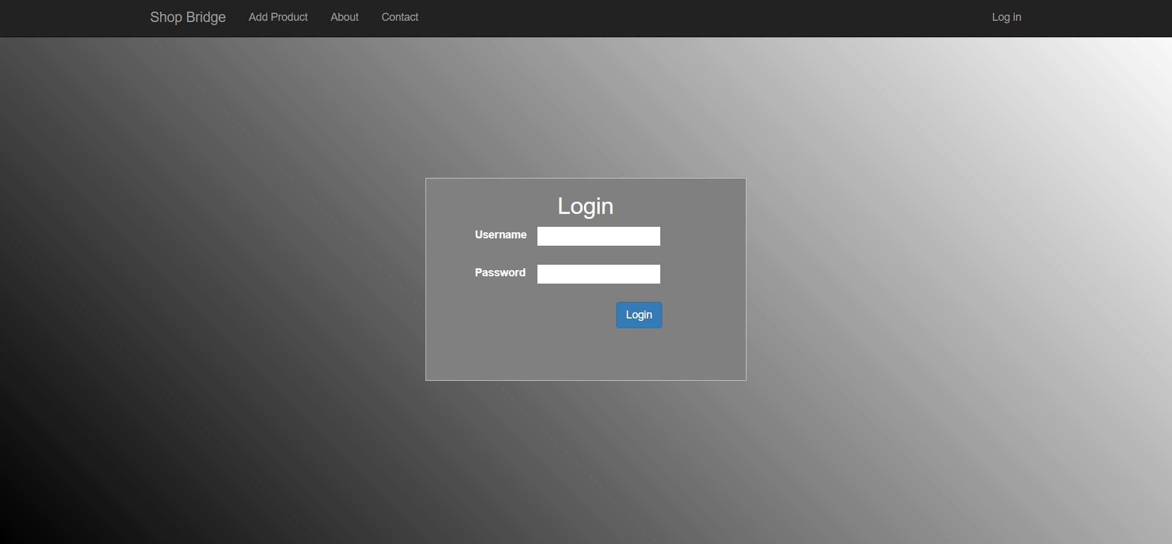
Login

Slide 6
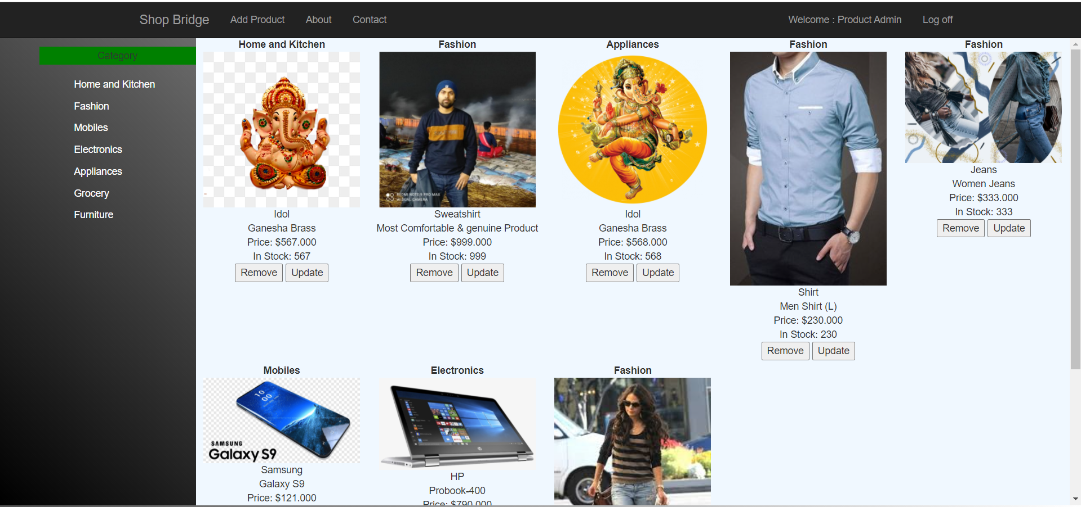
Shopping Page

Slide 7
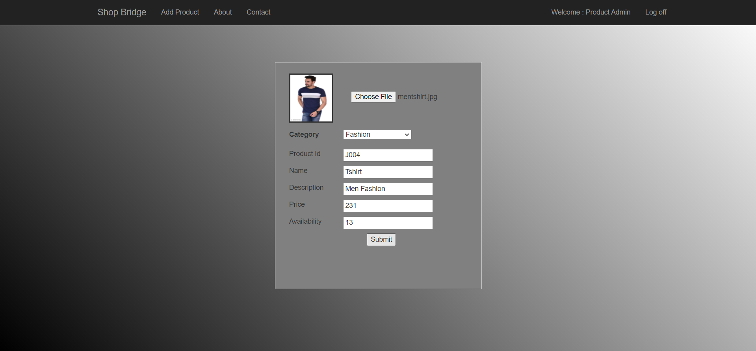
‘Add Product’ Module

Slide 8
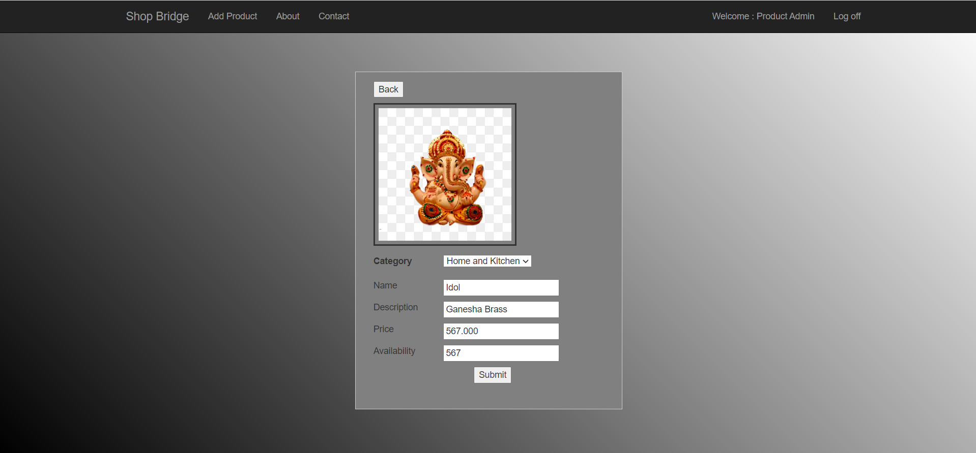
‘Update Product’Module

Slide 9
Remove/Update
On Click Remove, Remove product and navigate back to product list page.
On Click Update/Back, simply update and back to product list page.

Slide 10
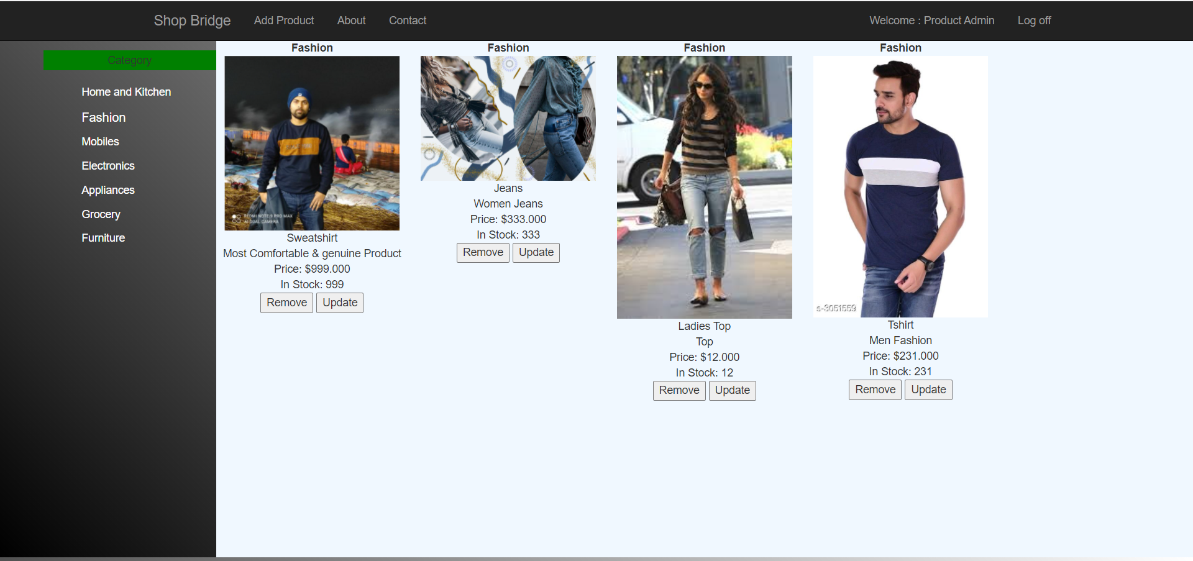
Click on any Category in left and it loads filtered result in right container
‘Category’ based Filter

Slide 11
LogOut
Session expired and user is now ready for fresh Login.

Slide 12
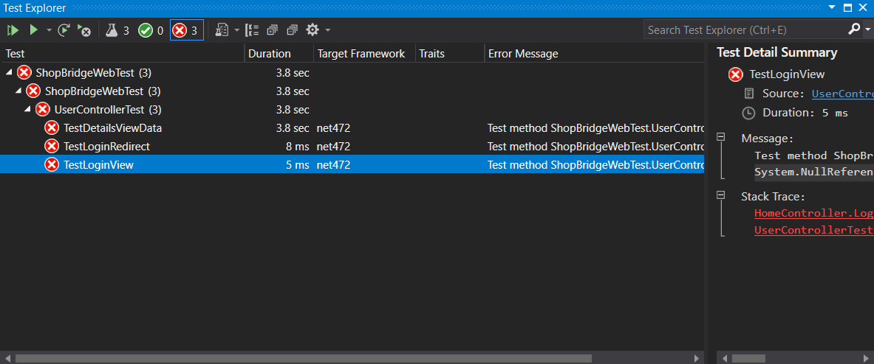
Unit Test

Slide 13
Thank You.!

